Slide 1


HFB AWARDS, CSR & SUSTAINABILITY INTIATIVES
Public

Slide 2
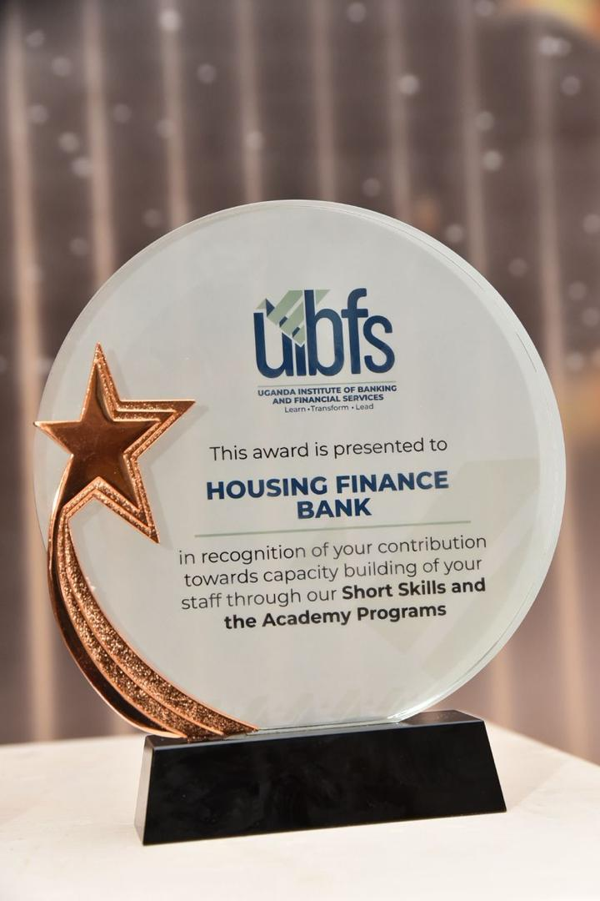
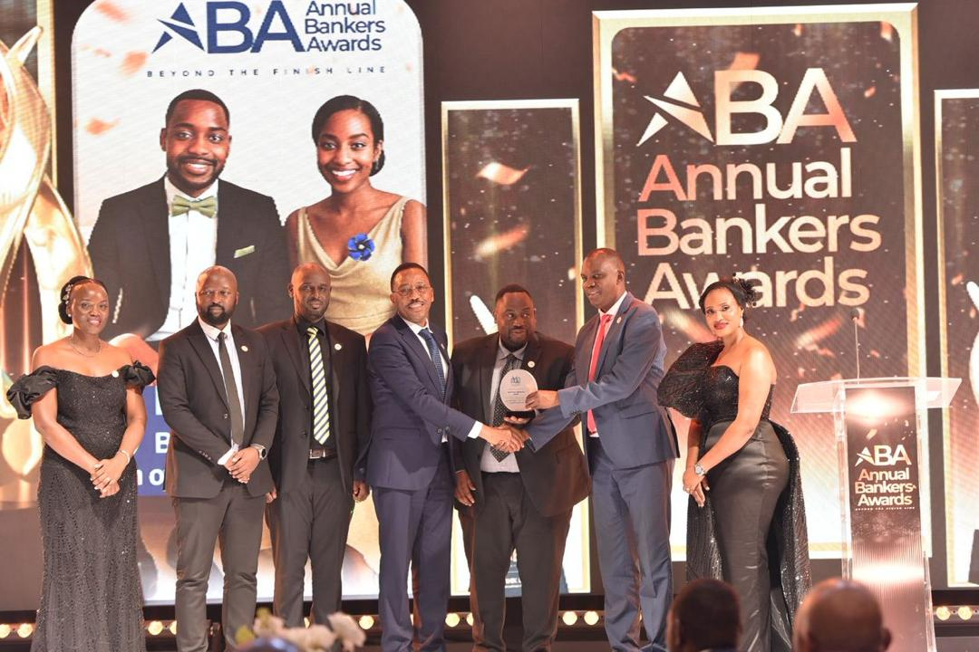
Awards 2026
Short Sills and the Academy Program
Housing Finance Bank attained recognition from the Uganda Institute of Banking and Financial Services for its commitment to staff capacity building through structured short skills and academy programmes.

Slide 3


Overall Winner – Football in the Bankers Gala 2025
Housing Finance Bank was recognized by the Uganda Institute of Banking and Financial Services (UBIFS) as the overall football winner at the Bankers Gala, underscoring strong teamwork, employee engagement, and the Bank’s commitment to promoting corporate wellness.

Slide 4
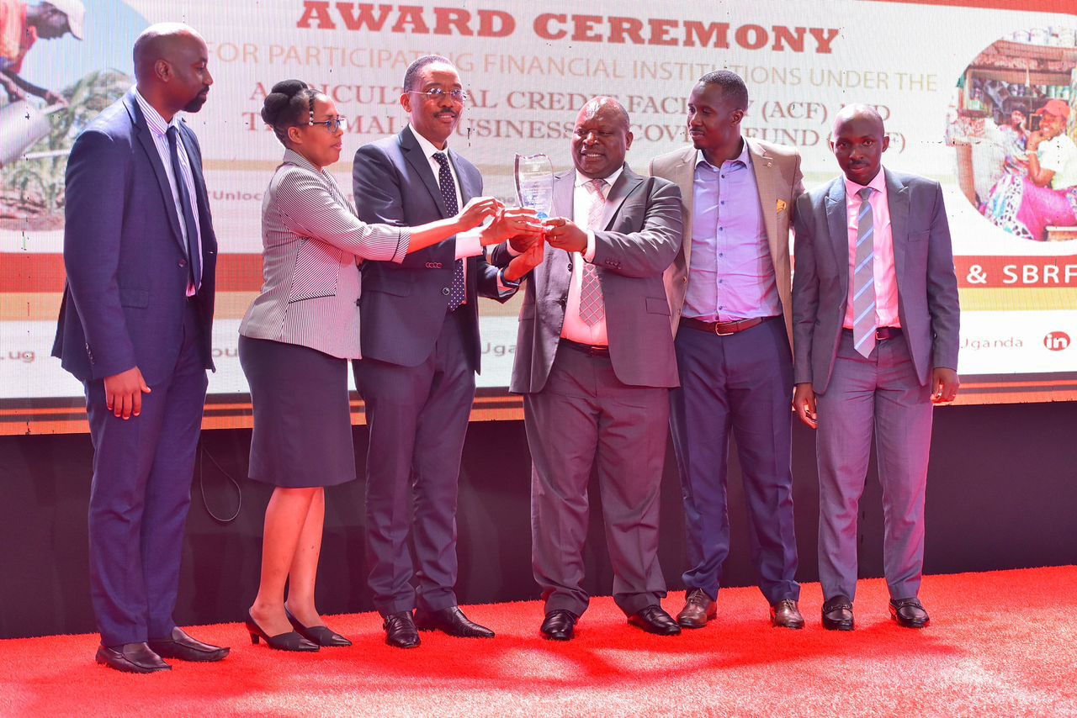
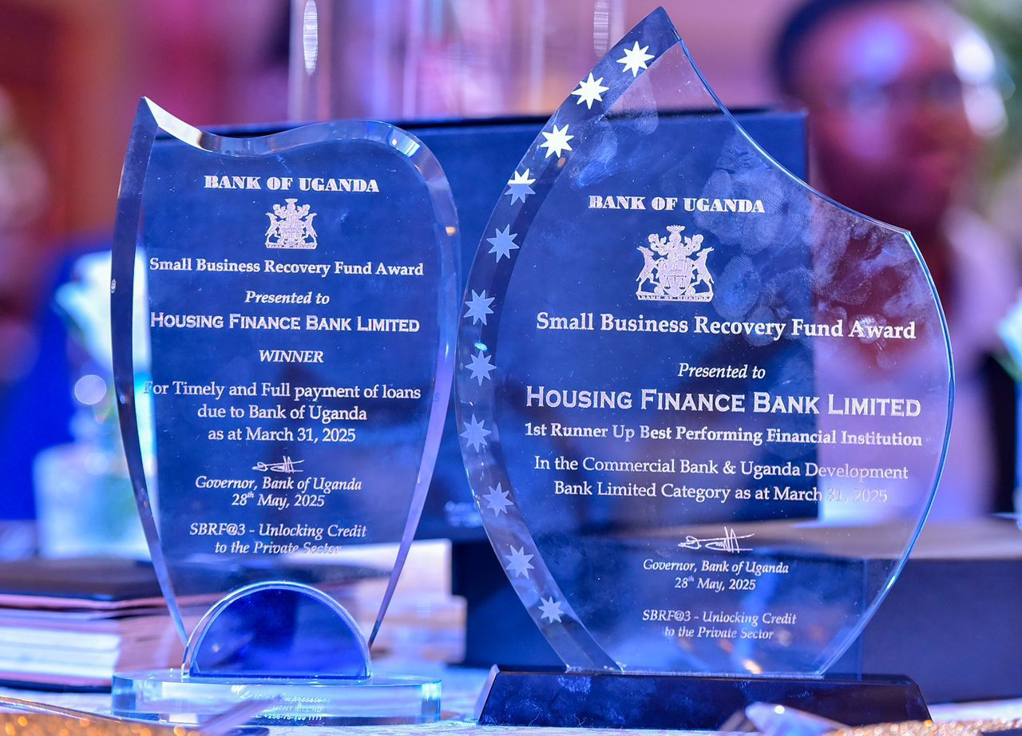
Bank of Uganda Awards
Bank of Uganda Small Business Recovery Fund Awards
Housing Finance Bank Uganda was recognized under the Small Business Recovery Fund Awards by the Bank of Uganda for its outstanding performance and commitment to supporting economic recovery.
Winner: Timely and Full Payment of Loans:
The Bank was awarded for its excellence in loan repayment discipline, demonstrating strong financial management and adherence to the terms of the recovery fund.
1st Runner-Up: Best Performing Financial Institution:
The Bank also emerged as the 1st runner-up in overall performance, reflecting its significant contribution to the effective implementation of the fund and its impact in supporting small businesses across Uganda.

Slide 5
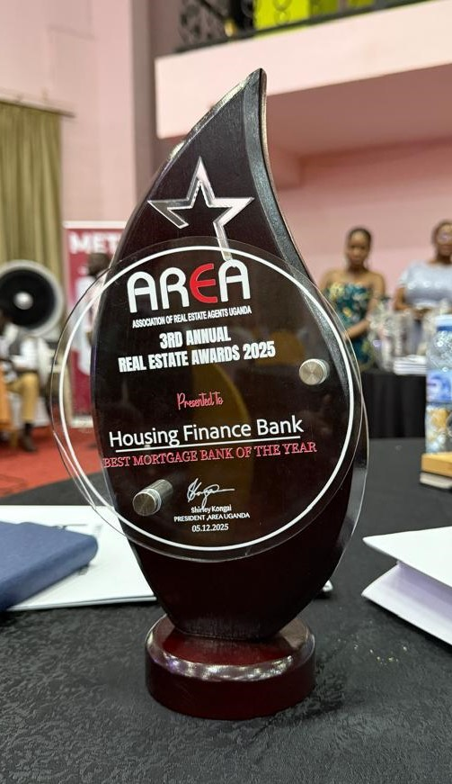
Association of Real Estate Agents Uganda – A.R.E.A Awards
Best Mortgage Bank of the Year
Housing Finance Bank Uganda was recognized as the Best Mortgage Bank of the Year 2025 at the AREA Awards, securing its second consecutive win in this category

Slide 6
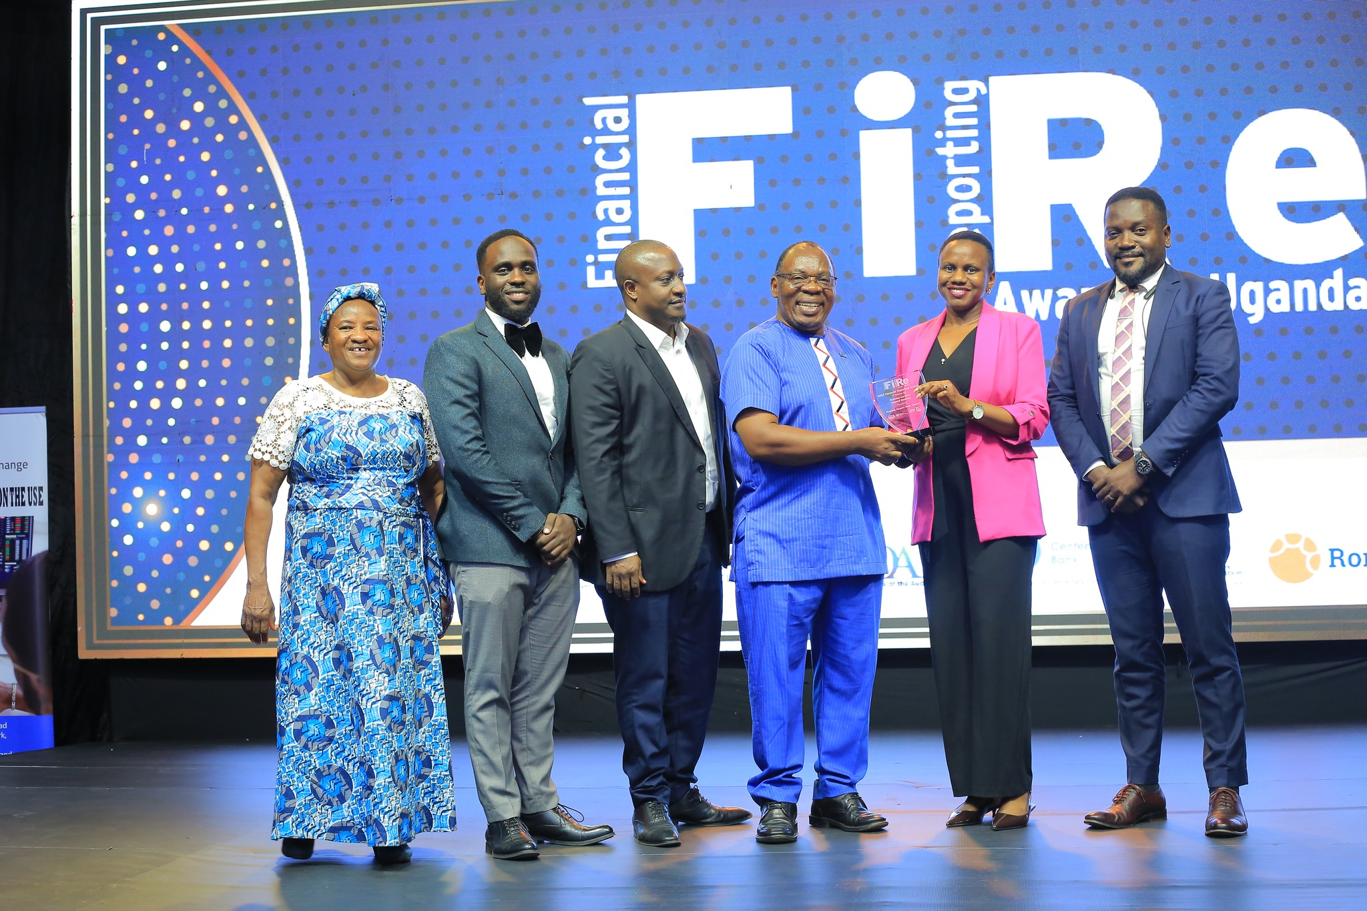
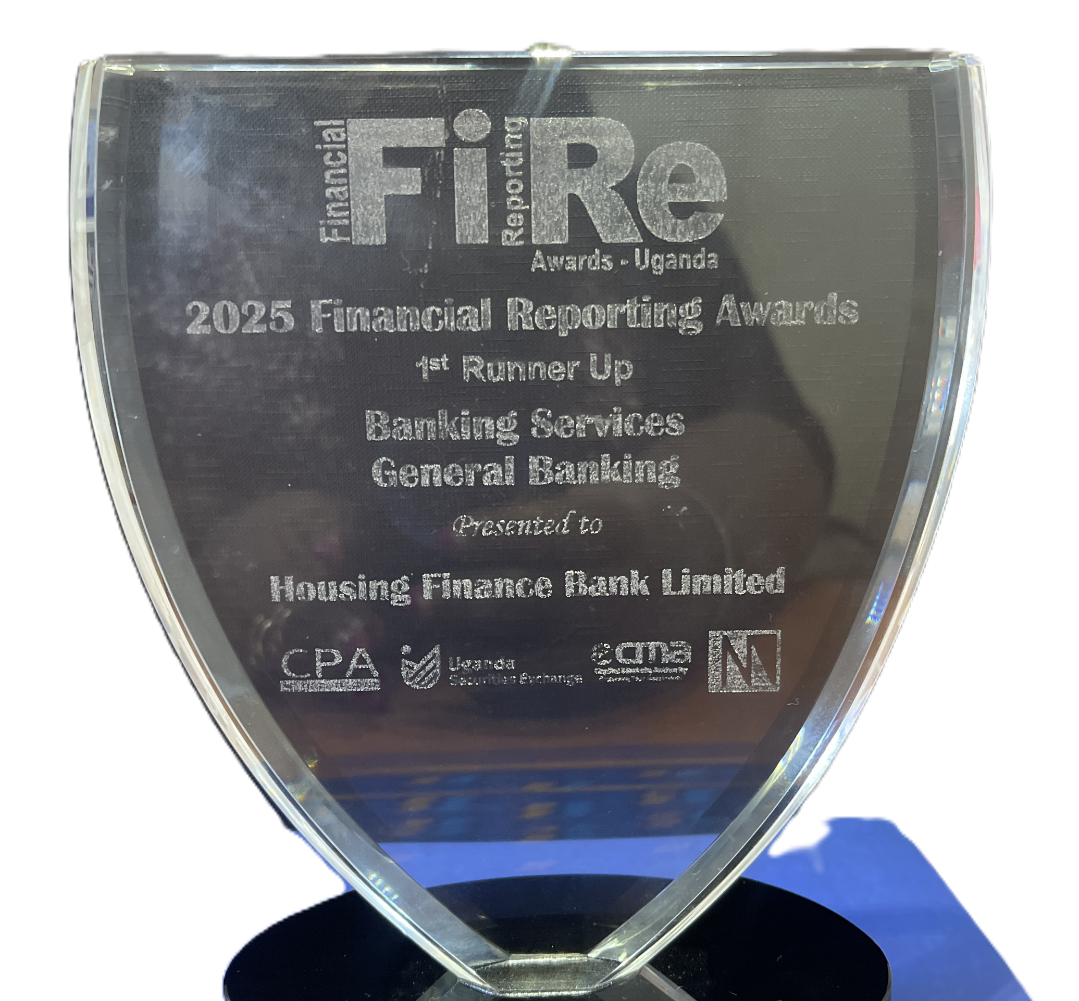
Financial Reporting Awards (F.i.R.e)
Financial Reporting (FiRe) Awards – Institute of Chartered Public Accountants of Uganda
Housing Finance Bank Uganda was recognized at the Financial Reporting (FiRe) Awards organized by the Institute of Chartered Public Accountants of Uganda, emerging as the 1st Runner-Up in the Banking Services and General Banking category.
This recognition highlights the Bank’s commitment to high-quality financial reporting, transparency, and accountability, reflecting strong governance practices and adherence to international reporting standards within Uganda.

Slide 7

ISO Certification 27001:2022
The Managing Director Michael K. Mugabi (second right) and Executive Director Peace Ayebazibwe (third right) together with other officials, officially receive the Bank’s ISO 27001:2022 Certificate

Slide 8
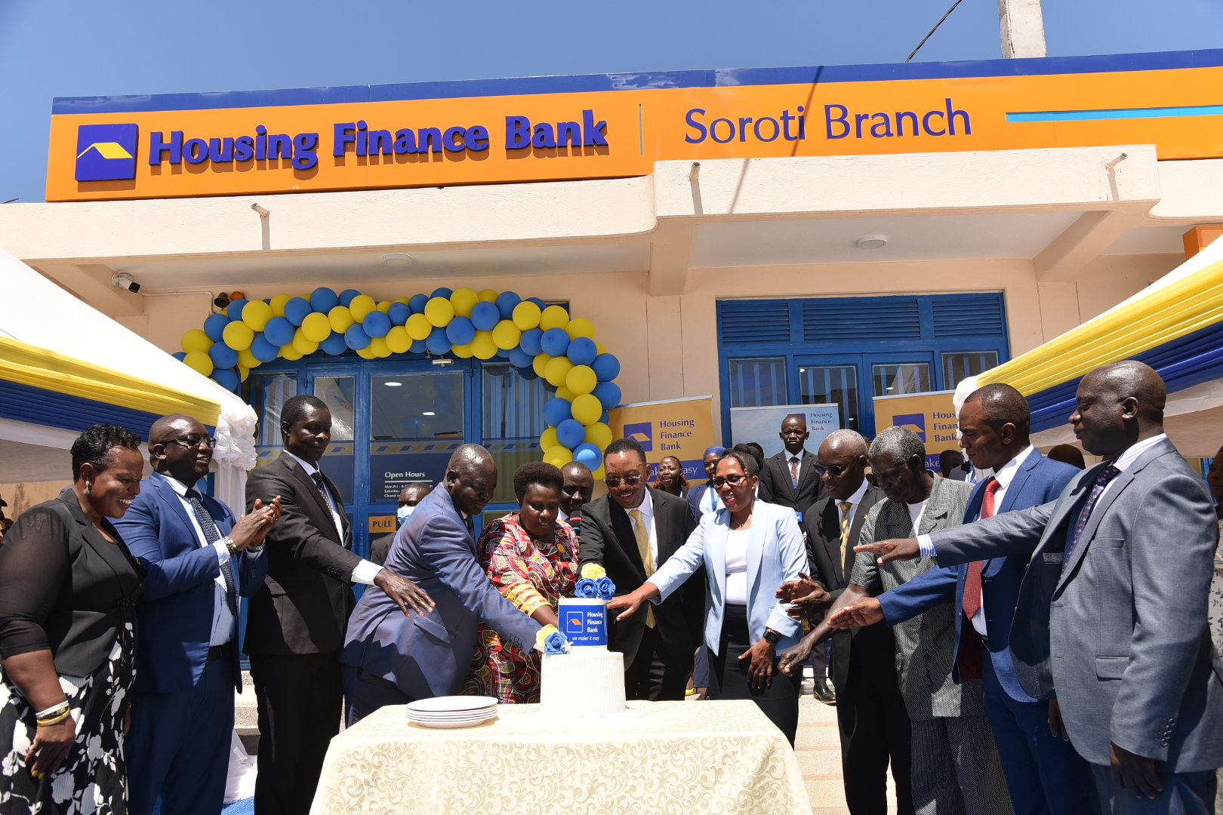
Opening Ceremony For Soroti Branch
Vice President Jessica Alupo and the Managing Director and cut the cake during the official launch of Housing Finance Bank’s Soroti Branch. Last year, the Bank expanded its network to 21 branches, with new locations in Masaka, Soroti, and Nansana cities.

Slide 9
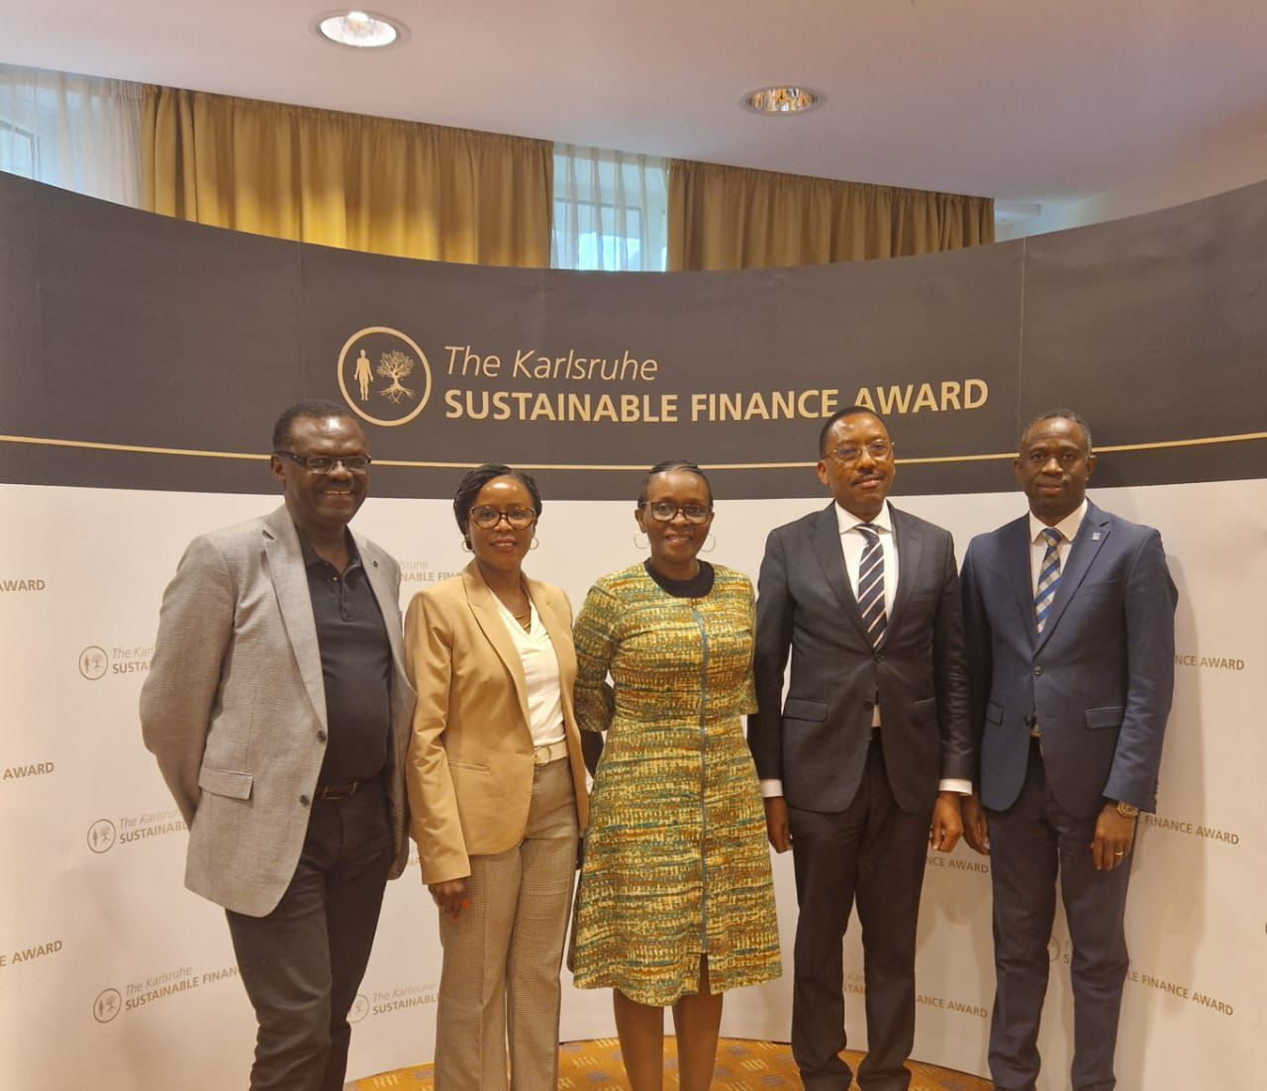
Journey Towards Our Sustainable Finance Certification
The Bank was represented at the Global Sustainable Finance Conference held in Karlsruhe, Germany, by the Board Chairperson, Ms. Josephine N. Mukumbya; Board Members Mr. Vincent Agaba and Mr. Patrick Ayota; the Managing Director, Mr. Michael K. Mugabi; marking an important milestone in the Bank’s journey towards Sustainable Finance Certification.

Slide 10
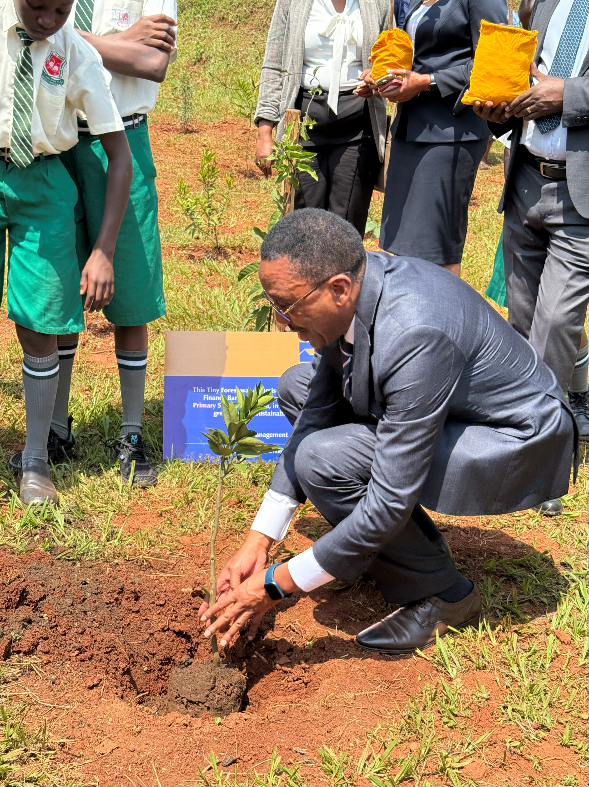
Advancing Environmental Stewardship Through the Tiny Forests Initiative
The Managing Director commissions a tree-planting activity at Kazo Primary School in Nansana. The Bank under its Tiny Forests Intiative is working towards a goal of planting 1 million trees by 2027, alongside other sustainability initiatives such as promoting green housing, environmental stewardship, and community resilience.

Slide 11

Transforming Public Education Through the NSSF Kampala Hills Run
As part of its Corporate Social Investment initiatives, Housing Finance Bank supported the NSSF Kampala Hills Run with a Ug. Shs 100 million sponsorship and, in partnership with the National Social Security Fund Uganda and other stakeholders, helped raise Ug Shs 1.5 billion to refurbish 10 public schools impacting over 1,000 pupils.

Slide 12
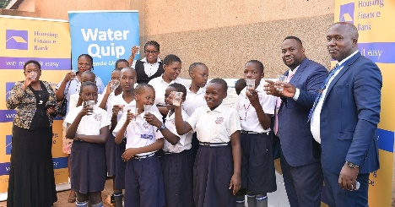
Improving Community Access to Clean Water
In partnership with WaterQuip Uganda, Housing Finance Bank extended clean drinking water access to over 1,000 students at St. Joseph Nursery and Primary School, Nansana.

Slide 13
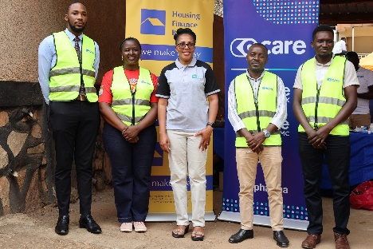
Bootcamp Partnership with C-Care
The Bank partnered with C-Care Uganda and St. Johns Church of Uganda Wandegeya to provide no cost health care to marginalized people from Katanga slums. Over 300 people were treated and accessed free medication
Bootcamp Partnership with C‑Care

Slide 14
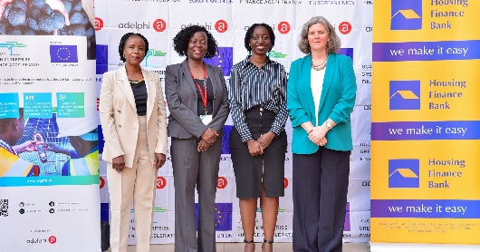
Partnership with the Uganda Green Enterprise Finance Accelerator (UGEFA)
In a strategic move towards sustainable banking practices, Housing Finance Bank partnered with the Uganda Green Enterprise Finance Accelerator (UGEFA) to provide tailored financing to SMEs in manufacturing, eco-friendly tourism, waste management and green mobility. Eligible businesses can apply for loans at HFB with UGEFA covering up to 33% of the loan principal.

Slide 15
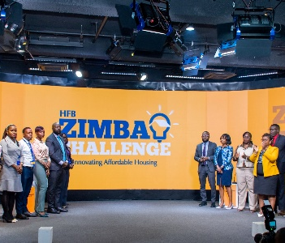
Launch of the HFB Zimba Challenge
Housing Finance Bank launched the Zimba Challenge Incubator to promote affordable housing, sustainable construction, and innovative building solutions nationwide.

Slide 16

Thank you.
Public
6

